Slide 1
Leveraging generative AI in research and policy analysis
Workshop on Empirical Research in the AI Era, 16th December 2024
Banco de Portugal Microdata Research Laboratory (BPLIM), Academia of Data Science
Dr. Jesse Lastunen
Research Associate, UNU-WIDER
lastunen@wider.unu.edu

Slide 2

Generative AI and LLMs
Traditional (“narrow”) AI focuses on specific tasks using predefined rules or logic
Generative AI enables the creation of new content, and includes Large Language Models (LLMs) that specialize in language – like Gemini, Claude and OpenAI’s o1
LLMs are based on transformer models with deep neural networks, benefiting from extensive pre-training and fine-tuning
Limitations include factual inaccuracies, privacy concerns, algorithmic bias, reproducibility, etc.
Despite limitations, LLMs offer insightful responses that can be helpful in a wide range of applications

Slide 3
Prompts
Prompts are user-provided inputs or queries that guide the model to generate specific, relevant responses
Prompt engineering involves crafting detailed, context-rich queries to steer LLMs towards producing relevant content
Prompt generators convert basic instructions describing a user’s intent into a more specific set of instructions that induce LLMs to generate higher-quality output
Achieving good results with LLMs requires careful prompting and iterative refinement – users need to understand what they are asking

Slide 4
LLMs for researchers and policy analysts
Recent advancements in GenAI, especially LLMs, have broadened the applicability of these tools in economics, policy analysis, and related work
LLMs excel in understanding data structures and abstract concepts and thereby performing cognitive tasks relevant to researchers
Commonly used tools/interfaces also come with built-in functionalities that allow users to upload files and perform data processing tasks
Focus of this presentation: practical overview of LLMs in research support tasks instead of direct research applications, following Korinek (2023/2024) and using lessons from work at a UN-affiliated development economics research organization
Korinek, A. (2023): “Generative AI for Economic Research: Use Cases and Implications for Economists“.
Journal of Economic Literature 61 (4): 1281–1317, and the Fall 2024 Update

Slide 5

Why should we care?
Accelerating progress
Improve the productivity of research efforts and the quality of research outputs
Anticipating
future developments
Private benefits
Allocate more time for critical thinking and our core competencies, and less time to the mechanical aspects of the work
Keeping track of the current capabilities offers insights into what the next versions of these systems will be capable of achieving
Mitigating risks
E.g. Authoritative sounding but inaccurate or biased outputs, challenges to education/homework, the risk of creating a digital divide, labour market impacts…

Slide 6
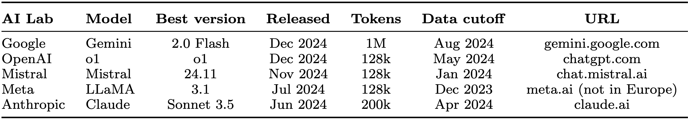
Commonly used LLMs as of December 2024
2024 improvements with top tools (also beyond textual prompts/responses):
Growing context windows
Better recall
Improved visual information processing
Voice conversations
Thinking in steps
AI controlling your screen
Reasoning agents, etc.
2M

Slide 7
Selected LLMs and interfaces
OpenAI’s ChatGPT at chatgpt.com
Use GPT-4o mini for free
ChatGPT Plus subscription is around $20/month, with access to more advanced models and tools
Other benefits: Custom “GPTs”, image generation, plugins for expanded capabilities, advanced voice mode
Google’s Gemini at gemini.google.com
Use 1.5 Flash for free, with internet access, image generation, and photo uploads
Premium subscription is around $20/month, with access to 2.0 Flash experimental,1.5 Pro with Deep Research, and others
Microsoft’s Copilot at copilot.microsoft.com
Sign up and use for free
Access to OpenAI’s GPT-4 Turbo model, web search, image generation ($ for Office integration)
Enterprise version protects your data
Anthropic’s Claude at claude.ai
Sign up and use the Sonnet 3.5 model for free, upload documents, internet access
Claude Pro is $20/month, with access to more advanced models, larger context window, etc.

Slide 8
Access to LLMs beyond chat interfaces
APIs: integrate LLMs directly into your software applications
More advanced and customizable use cases, more flexibility and control
Pay-per-use basis, need to sign up for an API key, write code to interact with API endpoints
Real-time voice assistants
Playgrounds or experimentation platforms
Experiment with different model settings, like temperature; more control over formats
Run open source LLMs locally on your own computer
Offline access, private, cost-effective, customizable

Slide 9
Other tools relevant for researchers
Consensus at consensus.app
A search engine that uses AI to find insights in +200M research papers
ChatGPT integration through a GPT plugin e.g. to use academic work as source material in generated text with full citations
NotebookLM at notebooklm.google.com
Upload and interact with Google Docs, PDFs, and web links
Summarize, generate questions, and create notes with AI assistance
Other similar search engines: elicit.com, scite.ai, ScholarAI.io, perplexity.ai
Some services allow you to use many different models, like poe.com
Computation, math: gpt.wolfram.com OpenAI “GPT”
Grammar and language: trinka.ai, wordvice.ai

Slide 10

Key domains where LLMs help economists and policy analysts
Ideation and feedback
Writing and editing
Background research
Promotion
Coding
Data analysis
Mathematical derivations
This framework and some of the example prompts presented come from:
Korinek, Anton (2023)
“Generative AI for Economic Research:
Use Cases and Implications for Economists“
Journal of Economic Literature
61 (4): 1281–1317
Fall 2024 Update: “Generative AI for Economic Research: LLMs Learn to Collaborate and Reason”

Slide 11
Ideation and feedback
Writing and editing
Background research
Promotion
Coding
Data analysis
Mathematical derivations

Slide 12
Ideation and feedback | Brainstorming
 | Research strategy
 | Feedback
 | Providing counterarguments
Writing and editing | Synthesizing text
 | Editing text
 | Evaluating text
 | Drafting academic text
 | Generating titles and headlines
Background research | Summarization
 | Literature search
 | Formatting references
 | Translating text
 | Explaining concepts
Promotion | Various use cases
Coding | Writing code
 | Explaining code
 | Translating code
 | Debugging code
 | Creating synthetic data
 | Creating scientific graphics
Data analysis | Creating figures
 | Extracting data from text
 | Reformatting data
 | Classifying and scoring text
 | Extracting sentiment
 | Simulating human subjects
Mathematical derivations | Setting up models
 | Deriving equations
 | Explaining models

Slide 13
Prompt responses here are generated using:
1. OpenAI's API ("o1-mini-2024-09-12”, i.e. o1-mini)
Requires paid subscription; deterministic and thus reproducible outputs
2. The Plus/Pro ChatGPT & Gemini web interfaces (different OpenAI & Gemini models)
Require paid subscriptions; results will differ every time a prompt is executed
Needed for GPTs, online search, uploading files, data analysis, etc.
Similar results can be expected with Claude, Mistral, etc.
The most trivial examples work relatively well with free versions and smaller models run locally

Slide 14
Ideation and feedback
Brainstorming
Research strategy
Feedback
Providing counterarguments

Slide 15
Ideation and feedback: Useful in all research settings
LLMs can generate a wide range of ideas from simple inputs
Iterative process: Generate, evaluate, and refine ideas
Key benefit: Outside perspective, support for overcoming confirmation/selection bias
More recent: Evaluate entire paper sections/drafts or compare several papers
Caveats:
Risk of homogenizing ideas and reducing critical thinking
Feedback on complex topics may be overly generic or misleading

Slide 16
Ideation and feedback: Brainstorming
PROMPT: I am using microsimulation to evaluate the 2023/24 personal income tax reform in Rwanda on inequality. Can you brainstorm an outline for the paper I’m writing?
RESPONSE:
tentative outline:
1. introduction
• brief background on the personal income tax system in Rwanda before the 2023/24 reform
• rationale for examining the tax changes and their intended goals
• significance of studying how these reforms affect inequality indicators
2. policy context and literature background
• overview of key features of the 2023/24 personal income tax reform
• summary of existing research on personal income taxation in Rwanda and similar contexts
• discussion of previous findings on how income tax reforms have shaped income distribution
3. data and microsimulation approach
• description of the data sources, including household income surveys and administrative tax records
• explanation of the microsimulation model and how it is calibrated to the Rwandan context
• assumptions about behavioral responses and how they are integrated into the model
4. baseline scenario and reform simulations
• description of the baseline scenario (pre-reform system) used as a reference point
• step-by-step outline of the policy changes implemented in the simulation for the 2023/24 reform
• discussion of how each policy shift is expected to alter the income distribution
5. results
6. robustness checks and sensitivity analysis
7. conclusion
(o1 via the ChatGPT Plus web interface, formatting added; last bullet points omitted)

Slide 17
Ideation and feedback: Brainstorming
PROMPT: I am using microsimulation to evaluate the 2023/24 personal income tax reform in Rwanda on inequality. Can you brainstorm an outline for the paper I’m writing?
RESPONSE:
tentative outline:
1. introduction
• brief background on the personal income tax system in Rwanda before the 2023/24 reform
• rationale for examining the tax changes and their intended goals
• significance of studying how these reforms affect inequality indicators
2. policy context and literature background
• overview of key features of the 2023/24 personal income tax reform
• summary of existing research on personal income taxation in Rwanda and similar contexts
• discussion of previous findings on how income tax reforms have shaped income distribution
3. data and microsimulation approach
• description of the data sources, including household income surveys and administrative tax records
• explanation of the microsimulation model and how it is calibrated to the Rwandan context
• assumptions about behavioral responses and how they are integrated into the model
4. baseline scenario and reform simulations
• description of the baseline scenario (pre-reform system) used as a reference point
• step-by-step outline of the policy changes implemented in the simulation for the 2023/24 reform
• discussion of how each policy shift is expected to alter the income distribution
5. results
6. robustness checks and sensitivity analysis
7. conclusion
(o1 via the ChatGPT Plus web interface, formatting added; last bullet points omitted)

Slide 18
Ideation and feedback: Brainstorming
PROMPT: I asked you earlier to create an outline for the research I’m doing on the PIT reform in Rwanda.
Could you provide some viewpoints I should consider when writing about the rationale for examining these tax changes and their intended goals.
For context, the reform increased the tax-exempt threshold in 2023 and lowered marginal rates for the top quartile. Be brief.
RESPONSE: • Assess whether the reform achieves its intended goals of reducing inequality and improving progressivity in Rwanda’s tax system.
• Understand the trade-offs between revenue generation and social equity, especially in the context of Rwanda’s development priorities.
• Analyze the implications of shifting tax burdens across income groups, with a focus on the top quartile and lower-income earners.
• Examine how the reform aligns with broader poverty reduction and inclusive growth strategies in Rwanda.
• Provide evidence on the effectiveness of PIT reforms in addressing inequality in a low-income country context, offering insights for future policy design.
(GPT-4o via the ChatGPT Plus web interface

Slide 19
Ideation and feedback: Providing counterarguments
PROMPT: I'm working on an economic model that predicts that eliminating VAT exemptions will increase inequality in a developing country. What are the top 5 counterarguments? One line each.
RESPONSE: 1. Informal sector dominance: If a large share of consumption by the poor occurs in the informal sector, which already evades VAT, removing formal exemptions has little impact on their relative tax burden.
2. Targeted compensation: Revenue gains from eliminating exemptions can finance targeted social programs (cash transfers, food subsidies) that specifically benefit low-income households, offsetting any regressive impact.
3. Reduced tax evasion: A broader VAT base with fewer exemptions simplifies tax administration and reduces incentives for evasion, potentially leading to more equitable revenue collection overall.
4. Progressive expenditure incidence: If the exempted goods and services are disproportionately consumed by wealthier households, removing exemptions could actually make the tax system more progressive.
5. Improved public services: Increased VAT revenue can fund essential public services (education, healthcare) that disproportionately benefit the poor, indirectly reducing inequality in the long run.
(Gemini Advanced v2.0 Flash;
first and last sentence omitted)

Slide 20
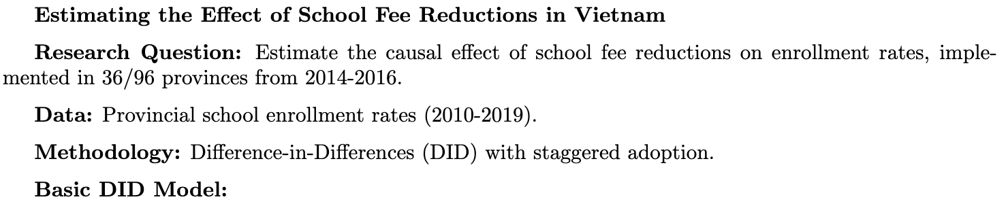
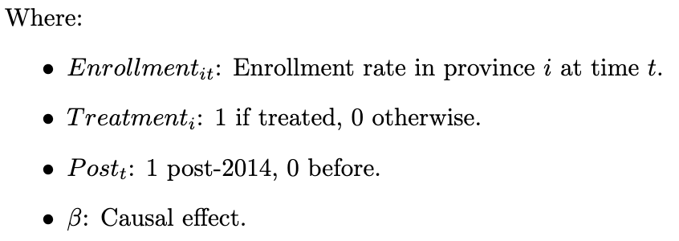
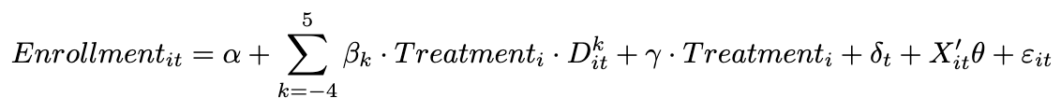
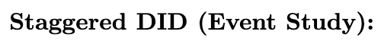
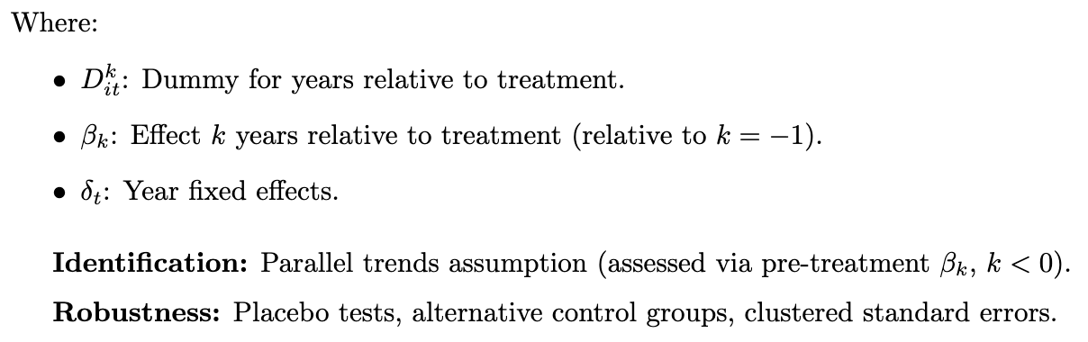
Ideation and feedback: Research strategy
PROMPT: I’d like to estimate the causal effect of school fee reductions on enrollment rates in Vietnam, implemented in 36 out of 96 provinces in phases from 2014 to 2016. I have data on school enrollment rates in all provinces from 2010 to 2019.
Which research strategy would you recommend? Write it up as a Latex document, focusing on the equations while keeping other explanations brief.
RESPONSE:
(Gemini Advanced v2.0 Flash;
LaTeX output;
discussion on identification and robustness omitted)

Slide 21
Writing and editing
Synthesizing text
Editing text
Evaluating text
Drafting academic text
Generating titles and headlines

Slide 22
Writing and editing: Streamline the writing process
LLMs excel in generating coherent text from fragmented inputs and editing text
Enhance existing text with additional context or examples
Create engaging paper titles, headlines, or summaries in another style
Evaluate and improve grammar, spelling, and clarity, or identify ambiguities
Caveats:
Generated text may lack human nuances
Outputs require thorough evaluation and amendment

Slide 23
Writing and editing: Synthesizing text
PROMPT: Write a paragraph in the style of an academic economist that integrates the following points. Include a topic sentence.
progressive taxation plays a big role in mitigating income inequality in developing countries
the effectiveness of such systems is often hampered by low compliance rates, large informal sector, etc. [discuss additional challenges]
economists must explore strategies like leveraging tech for better tax enforcement [offer additional solutions]
it is also important to consider international cooperation to combat tax evasion [also offer specific ways in which this can be done]
conclude by stating a balance must be struck between ensuring tax fairness and avoiding overly burdensome taxation [discussing why]
RESPONSE: Progressive taxation is instrumental in mitigating income inequality in developing countries by ensuring that higher earners contribute proportionally more to public revenue, thereby enabling the provision of essential services and social safety nets. However, the effectiveness of progressive tax systems in these contexts is frequently undermined by challenges such as low compliance rates, the prevalence of large informal sectors, limited administrative capacity, and inadequate legal frameworks. To enhance the efficacy of progressive taxation, economists must explore strategies such as broadening the tax base to include previously untaxed activities, leveraging digital technologies for improved tax collection and enforcement, and implementing simplified tax regimes that reduce the compliance burden. Additionally, fostering international cooperation is crucial to combat tax evasion, which can be achieved through the establishment of global information-sharing agreements, harmonizing tax policies to prevent base erosion and profit shifting, and supporting capacity-building initiatives in developing nations. Ultimately, a delicate balance must be struck between ensuring tax fairness and avoiding overly burdensome taxation, as excessive tax pressures can disincentivize investment and economic growth, thereby potentially exacerbating the very inequalities the tax system seeks to alleviate.
(o1-mini via ChatGPT API)

Slide 24
Writing and editing: Synthesizing text
PROMPT: Write a paragraph in the style of an academic economist that integrates the following points. Include a topic sentence.
progressive taxation plays a big role in mitigating income inequality in developing countries
the effectiveness of such systems is often hampered by low compliance rates, large informal sector, etc. [discuss additional challenges]
economists must explore strategies like leveraging tech for better tax enforcement [offer additional solutions]
it is also important to consider international cooperation to combat tax evasion [also offer specific ways in which this can be done]
conclude by stating a balance must be struck between ensuring tax fairness and avoiding overly burdensome taxation [discussing why]
RESPONSE: Progressive taxation is instrumental in mitigating income inequality in developing countries by ensuring that higher earners contribute proportionally more to public revenue, thereby enabling the provision of essential services and social safety nets. However, the effectiveness of progressive tax systems in these contexts is frequently undermined by challenges such as low compliance rates, the prevalence of large informal sectors, limited administrative capacity, and inadequate legal frameworks. To enhance the efficacy of progressive taxation, economists must explore strategies such as broadening the tax base to include previously untaxed activities, leveraging digital technologies for improved tax collection and enforcement, and implementing simplified tax regimes that reduce the compliance burden. Additionally, fostering international cooperation is crucial to combat tax evasion, which can be achieved through the establishment of global information-sharing agreements, harmonizing tax policies to prevent base erosion and profit shifting, and supporting capacity-building initiatives in developing nations. Ultimately, a delicate balance must be struck between ensuring tax fairness and avoiding overly burdensome taxation, as excessive tax pressures can disincentivize investment and economic growth, thereby potentially exacerbating the very inequalities the tax system seeks to alleviate.
(o1-mini via ChatGPT API)

Slide 25
Writing and editing: Editing text
PROMPT: Give a concise list of the top 5 stylistic shortcomings of the following abstract:
In the wake of the COVID-19 pandemic, several countries enacted tax and social protection measures to help mitigate the economic hardship faced by individuals and households. This experience underscores the need to better understand the impact of such programmes on incomes and poverty during crises, especially in low- and middle-income countries (LMICs) where they are most needed. This paper reviews existing empirical literature on the subject, conducting a scoping review on quantitative studies published between 2000 and 2022. Following a structured selection approach, we identify 39 studies about the role of social protection and taxation in LMICs during periods of crisis. The results reveal that LMICs often enact both vertical and horizontal expansions of existing unconditional cash transfer schemes during crises, although the applications vary by geography. Our research also suggests a sharp increase in recent studies because of the COVID-19 pandemic, and a large variaety of methods used to study the subject. In terms of effects, social protection can help cushion households against crises, but the effect size depends on the policy adopted, country context, and type of crisis. The minimal empirical evidence about tax policy studies do not enable us to draw conclusions.
Typographical Error: The word "variaety" is misspelled and should be corrected to "variety," which detracts from the professional presentation.
Redundancy and Wordiness: Phrases like "in the wake of" and "underscores the need to better understand" could be more concise, making the abstract clearer and more direct.
Use of Unexplained Jargon: Terms such as "vertical and horizontal expansions" are specialized and may not be immediately understandable to all readers without further clarification.
Inconsistent Sentence Structure: The abstract shifts between different sentence structures and perspectives, which can disrupt the flow and coherence of the text.
Lack of Clarity in Conclusions: The final sentence is vague regarding the implications of the minimal empirical evidence on tax policy, leaving the reader uncertain about the study's definitive outcomes.
RESPONSE:
(o1-mini via ChatGPT API)

Slide 26
Writing and editing: Editing text
PROMPT: Give a concise list of the top 5 stylistic shortcomings of the following abstract:
In the wake of the COVID-19 pandemic, several countries enacted tax and social protection measures to help mitigate the economic hardship faced by individuals and households. This experience underscores the need to better understand the impact of such programmes on incomes and poverty during crises, especially in low- and middle-income countries (LMICs) where they are most needed. This paper reviews existing empirical literature on the subject, conducting a scoping review on quantitative studies published between 2000 and 2022. Following a structured selection approach, we identify 39 studies about the role of social protection and taxation in LMICs during periods of crisis. The results reveal that LMICs often enact both vertical and horizontal expansions of existing unconditional cash transfer schemes during crises, although the applications vary by geography. Our research also suggests a sharp increase in recent studies because of the COVID-19 pandemic, and a large variaety of methods used to study the subject. In terms of effects, social protection can help cushion households against crises, but the effect size depends on the policy adopted, country context, and type of crisis. The minimal empirical evidence about tax policy studies do not enable us to draw conclusions.
Typographical Error: The word "variaety" is misspelled and should be corrected to "variety," which detracts from the professional presentation.
Redundancy and Wordiness: Phrases like "in the wake of" and "underscores the need to better understand" could be more concise, making the abstract clearer and more direct.
Use of Unexplained Jargon: Terms such as "vertical and horizontal expansions" are specialized and may not be immediately understandable to all readers without further clarification.
Inconsistent Sentence Structure: The abstract shifts between different sentence structures and perspectives, which can disrupt the flow and coherence of the text.
Lack of Clarity in Conclusions: The final sentence is vague regarding the implications of the minimal empirical evidence on tax policy, leaving the reader uncertain about the study's definitive outcomes.
RESPONSE:
(o1-mini via ChatGPT API)

Slide 27
Other use cases in ‘writing and editing’
Editing text
PROMPT: Can you rewrite the abstract to correct for shortcomings you identified?
PROMPT: Can you rewrite this paragraph to make it attractive and understandable to non-academic audiences?
PROMPT: Provide 5 obvious improvements that this paper needs before I can submit it to a journal. [attach the paper]
PROMPT: Compare the methods used in the two papers attached. [attach the papers]
Evaluating text (with advanced tools allowing for attachments)
Drafting academic text (with advanced tools allowing for web/article search) – use with care
PROMPT: I want to write a literature review for my research on VAT compliance among informal small firms in Kigali.
It will cover several topics, but I would appreciate your help on the subsection on VAT compliance in Rwanda, with possible comparisons to other countries. Write the first draft of this section of the literature review based on relevant academic literature, where possible from high-impact journals.
Make it comprehensive, with several references/sources and ample detail.

Slide 28
Background research
Summarizing text
Literature search
Formatting references
Translating text
Explaining concepts

Slide 29
Background research: Micro tasks behind the core work
LLMs help streamline background research, like literature search, in various ways
Simple: Format references across styles, translate texts, explain concepts
More complex: Find and cite relevant papers, search dozens of sources to get an answer to a question (esp. with Gemini Pro 1.5 with Deep Research)
Caveats:
Potential for fictional (or irrelevant) references
Verification is crucial
Outputs can be shallow

Slide 30
Background research: Literature search
PROMPT: Find 5 papers from reputable economics journals that analyze the effects of conditional cash transfer programs on poverty or inequality in African or Latin American countries. For now, I only need the title, authors, and journal as well as a two-sentence summary.
RESPONSE: Here are five studies […]
1. “Conditional Cash Transfers, Resources, and Political Participation in Latin America”
Author: Gregory S. Schober, Journal: Latin American Research Review (2019)
Summary: This study investigates how CCT programs in Latin America influence political participation. The findings suggest that recipients of CCTs are more likely to engage in political activities, indicating that such programs can enhance democratic engagement among the poor.
2. “Cash Transfers in Latin America: Effects on Poverty and Redistribution”
Authors: Nora Lustig, Carola Pessino, John Scott, Journal: Economía (2014)
Summary: This paper evaluates the impact of cash transfer programs on poverty and income distribution in Latin America. The authors find that these programs have significantly reduced poverty and inequality, with varying degrees of effectiveness across different countries.
3. “Heterogeneous Impacts of Conditional Cash Transfers: Evidence from Nicaragua”
Author: Ana C. Dammert, Journal: Economic Development and Cultural Change (2009)
Summary: This research examines the varied effects of Nicaragua’s CCT program on child labor and school attendance. It shows that the program effectively reduces child labor and increases school attendance, with more pronounced benefits for certain demographic groups.
4. “Conditional Cash Transfers as a Tool of Social Policy”
Author: Armando Barrientos, Journal: Economic and Political Weekly (2011)
Summary: This article discusses the role of CCT programs in social policy, focusing on their design and implementation in low- and middle- income countries, particularly in Latin America. It highlights the importance of program design in achieving desired social outcomes.
5. “Evaluating the Impact of Conditional Cash Transfer Programs: Lessons from Latin America”
Authors: Laura B. Rawlings, Gloria M. Rubio, Journal: World Bank Research Observer (2005)
Summary: This paper assesses the effectiveness of CCT programs in Latin America in reducing poverty and promoting human capital development. The authors conclude that these programs have been successful in improving health and education outcomes among the poor.
These studies provide valuable insights into the effectiveness of CCT programs in addressing poverty and inequality in African and Latin American contexts.
(GPT-4o via ChatGPT Plus web interface, incl. web search and links to JSTOR;
formatting edited)

Slide 31
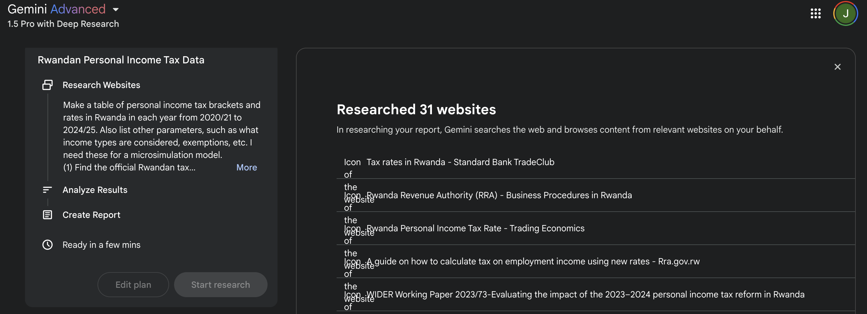
Background research: Literature search
PROMPT: Make a table of personal income tax brackets and rates in Rwanda in each year from 2020/21 to 2024/25. Also list other parameters, such as what income types are considered, exemptions, etc. I need these for a microsimulation model.
(Gemini Advanced 1.5 Pro with Deep Research; Gemini web interface)

Slide 32
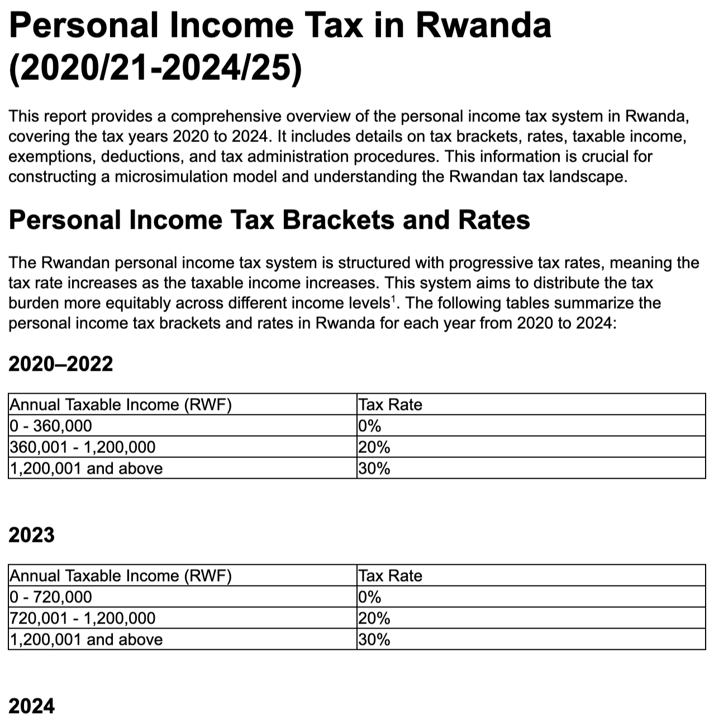
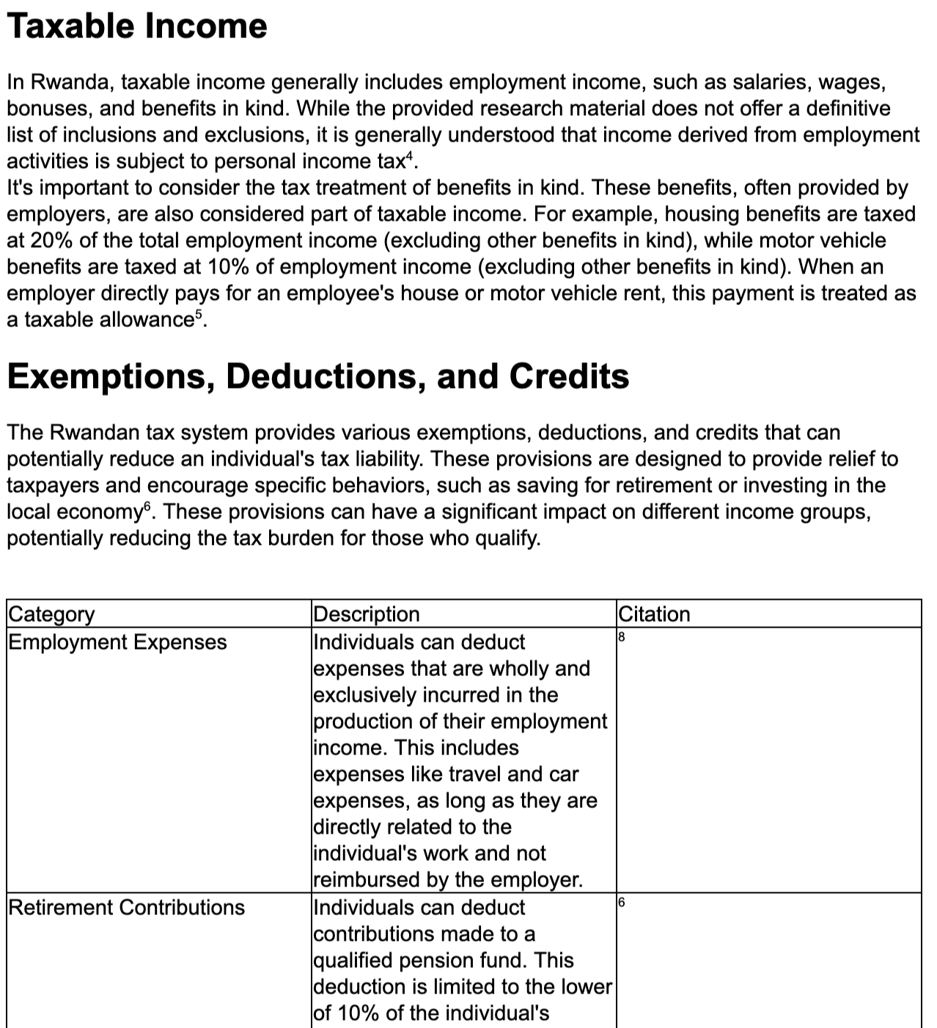
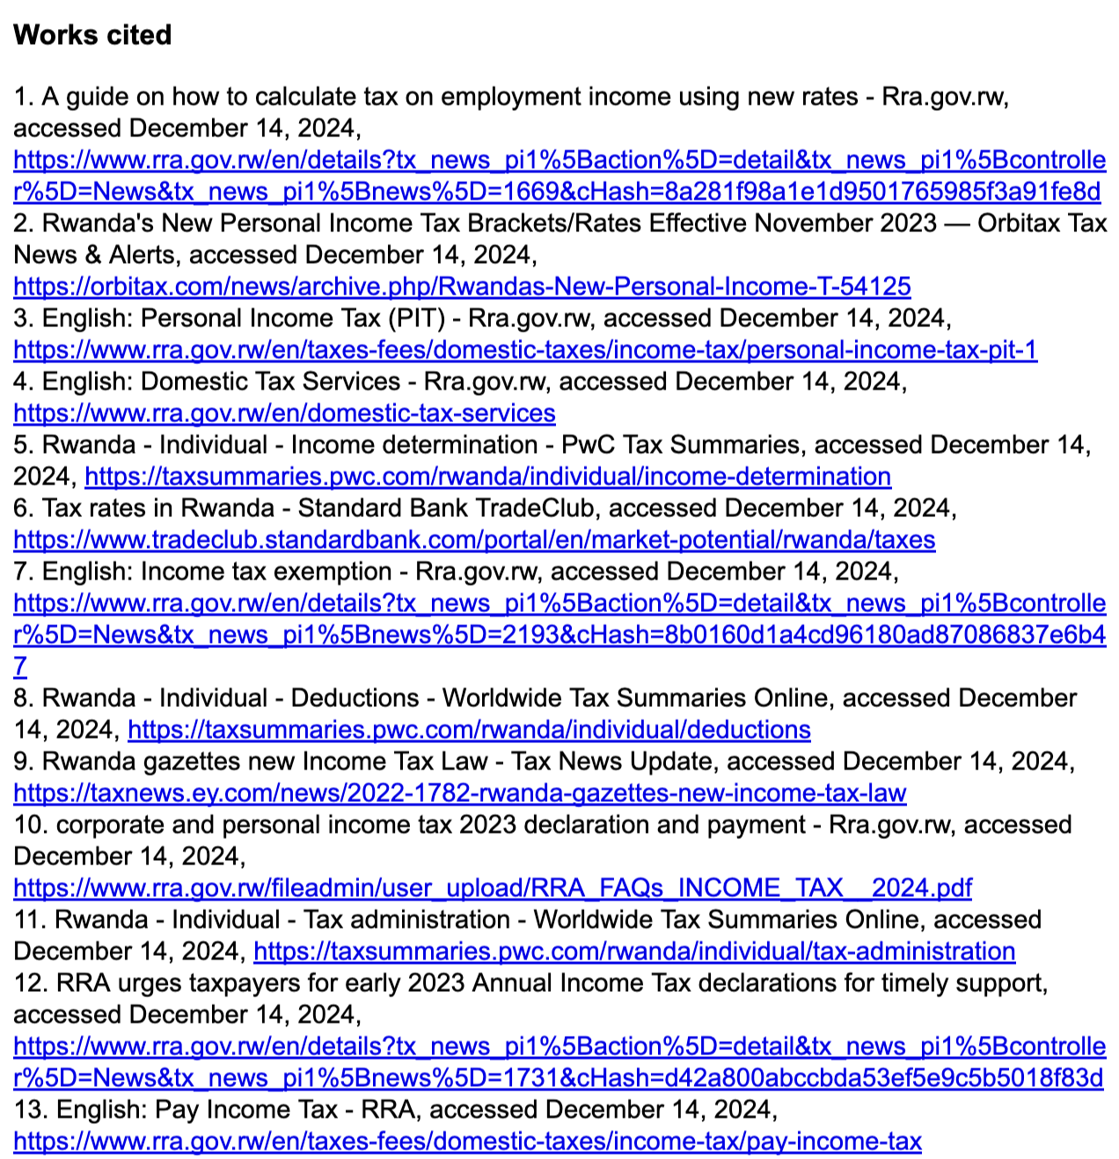
Background research: Literature search
PROMPT: Make a table of personal income tax brackets and rates in Rwanda in each year from 2020/21 to 2024/25. Also list other parameters, such as what income types are considered, exemptions, etc. I need these for a microsimulation model.
RESPONSE:
(Gemini Advanced Pro 1.5 with Deep Research;
Gemini web interface;
some parts of the Google doc created)
(Gemini Advanced 1.5 Pro with Deep Research; Gemini web interface)

Slide 33
Other use cases in ‘background research’
Formatting references
PROMPT: Convert this reference to bibtex format:
Gibson Masumbu and Kristi Mahrt: Assessing Progress in Welfare Improvements in Zambia: A Multidimensional Approach.
In book: Growth and Poverty in Sub-Saharan Africa. Editors: Channing Arndt, Andy McKay, Finn Tarp. April 2016, Oxford University Press, Number of Pages 528
PROMPT: Translate the following sentence into Spanish, German, and Finnish:
“This book comprehensively evaluates trends in living conditions in 16 major sub-Saharan African countries, corresponding to nearly 75% of the total population.”
PROMPT: How should commodity taxes be set in a developing country context as a part of the overall tax-benefit system? Discuss the normative aspects involved on the basis of public economics theory. Also comment on the relevant empirical information one would need to have to be able to make policy recommendations.
PROMPT: What factors determine the elasticity of intertemporal substitution, and why does it matter for understanding savings behavior and fiscal policy effectiveness?
Translating text
Explaining concepts

Slide 34
Coding
Writing code
Explaining code
Translating code
Debugging code
Creating synthetic data
Creating scientific graphics

Slide 35
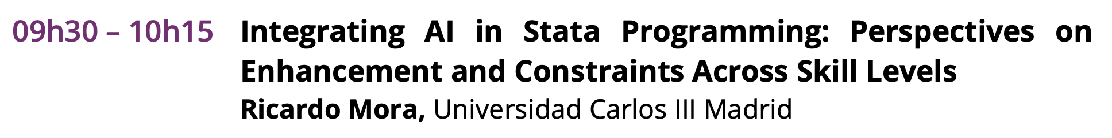
Coding: An LLM as your everyday coding assistant
LLMs help write, edit, optimize, and debug code in Python, R, STATA, etc.
Best used as an everyday coding assistant
Helps explain your colleague’s badly commented code in plain English
Works well as a tutor for unfamiliar programming languages and libraries
Caveats:
Code outputs may contain errors, necessitating iteration and thorough user review

Slide 36
Coding: Writing code
PROMPT:
I have an output dataset from a Vietnamese microsimulation model, stored in "/Users/user/Desktop/vn_2023_std.txt". Help me write efficient Stata code for four tasks:
1. to insheet the txt file to Stata
2. to obtain a histogram of the distribution of variable 'ils_dispyx' (disposable income), among individuals between the ages of 18 and 64 (age='dag')
3. to calculate the share of individuals with zero disposable income
4. to calculate average disposable income among informal ('lfo'=0) and formal ('lfo'=1) workers.
Where required, use survey weights (variable 'dwt'). Provide the entire code that I can copy-paste to Stata to accomplish all tasks, with no other text.
Avoid using the svyset package, just show how to make the calculations.
RESPONSE (GPT-4 Turbo via Microsoft Copilot, Precise mode):
Here is the Stata code for your tasks:
// Task 1: Insheet the txt file to Stata
insheet using "/Users/user/Desktop/vn_2023_std.txt", clear
// Task 2: Obtain a histogram of the distribution of variable 'ils_dispyx' among individuals between the ages of 18 and 64
histogram ils_dispyx if dag >= 18 & dag <= 64, frequency
// Task 3: Calculate the share of individuals with zero disposable income
gen zero_income = ils_dispyx == 0
egen total_weight = total(dwt)
egen zero_income_weight = total(dwt) if zero_income == 1
gen zero_income_share = zero_income_weight / total_weight
sum zero_income_share
// Task 4: Calculate average disposable income among informal and formal workers
egen informal_weight = total(dwt) if lfo == 0
egen formal_weight = total(dwt) if lfo == 1
egen informal_income = total(ils_dispyx * dwt) if lfo == 0
egen formal_income = total(ils_dispyx * dwt) if lfo == 1
gen avg_informal_income = informal_income / informal_weight
gen avg_formal_income = formal_income / formal_weight
sum avg_informal_income avg_formal_income
Please replace the file path with the actual path of your file if it’s different. Also, make sure that the variable names match those in your dataset. If there are any issues, please let me know! I’m here to help. 😊

Slide 37
Coding: Explaining code
PROMPT:
Explain this Stata code in 10 short bullets:
* Folder with output datasets:
global output "/Users/user/Desktop"
* Years, definitions, and income concepts:
global years = "2022 2023"
global Nyear: word count ${years}
global definitions = "dispyx con"
global Ndef: word count ${definitions}
* Poverty rate matrix:
mat povR = J(${Ndef},${Nyear},.)
mat colnames povR = ${years}
mat rownames povR = "Disposable income" "Consumption"
matnames povR
mat list povR
* Loop to calculate poverty rates:
local col = 1
foreach year of global years {
insheet using "${output}//vn_`year'_std.txt", clear
* Equivalence scale (national definition)
bysort idhh: gen ses_hh = sum(ses)
* Household level equivalised income and consumption
quietly foreach def of global definitions {
bysort idhh: egen temp = total(ils_`def')
gen `def'_equ = temp / ses_hh
gen `def'_neg = `def'_equ
replace `def'_neg = 0 if `def'_neg<0
drop temp
}
* Matrix:
local row = 1
foreach def of global definitions {
povdeco `def'_neg [aw=dwt], varpline(spl)
mat povR[`row',`col'] = r(fgt0) * 100
local row = `row'+ 1
}
local col = `col'+1
}
RESPONSE (o1-mini via the ChatGPT Plus web interface):
Set Output Directory: Defines a global macro output pointing to "/Users/user/Desktop" for storing input and output datasets.
Specify Years: Creates a global macro years with the values "2022 2023" and counts the number of years (Nyear = 2).
Define Income Concepts: Establishes a global macro definitions with "dispyx con" and counts the definitions (Ndef = 2).
Initialize Poverty Matrix: Creates a matrix povR with Ndef rows and Nyear columns, naming rows as “Disposable income” and “Consumption” and columns as the specified years.
Loop Initialization: Sets a local counter col to 1 to track the current column in the povR matrix.
Import Yearly Data: For each year in years, loads the corresponding dataset (e.g., vn_2022_std.txt) from the output directory using insheet.
Calculate Equivalence Scale: Groups data by household ID (idhh) and generates ses_hh, the sum of socio-economic status (ses) for each household.
Compute Equivalised Measures: For each income definition, calculates total income/consumption per household, divides by ses_hh to get equivalised values, sets negative values to zero, and removes temporary variables.
Calculate Poverty Rates: For each income definition, runs the povdeco command with the equivalised and non-negative income/consumption, applies sampling weights (dwt), retrieves the poverty rate (fgt0), converts it to a percentage, and stores it in the povR matrix.
Update Matrix and Finalize: Increments the column counter after each year, resulting in the povR matrix containing poverty rates (%) for “Disposable income” and “Consumption” across 2022 and 2023.

Slide 38
Coding: Explaining code
PROMPT:
Explain this Stata code in 10 short bullets:
* Folder with output datasets:
global output "/Users/user/Desktop"
* Years, definitions, and income concepts:
global years = "2022 2023"
global Nyear: word count ${years}
global definitions = "dispyx con"
global Ndef: word count ${definitions}
* Poverty rate matrix:
mat povR = J(${Ndef},${Nyear},.)
mat colnames povR = ${years}
mat rownames povR = "Disposable income" "Consumption"
matnames povR
mat list povR
* Loop to calculate poverty rates:
local col = 1
foreach year of global years {
insheet using "${output}//vn_`year'_std.txt", clear
* Equivalence scale (national definition)
bysort idhh: gen ses_hh = sum(ses)
* Household level equivalised income and consumption
quietly foreach def of global definitions {
bysort idhh: egen temp = total(ils_`def')
gen `def'_equ = temp / ses_hh
gen `def'_neg = `def'_equ
replace `def'_neg = 0 if `def'_neg<0
drop temp
}
* Matrix:
local row = 1
foreach def of global definitions {
povdeco `def'_neg [aw=dwt], varpline(spl)
mat povR[`row',`col'] = r(fgt0) * 100
local row = `row'+ 1
}
local col = `col'+1
}
RESPONSE (o1-mini via the ChatGPT Plus web interface):
Set Output Directory: Defines a global macro output pointing to "/Users/user/Desktop" for storing input and output datasets.
Specify Years: Creates a global macro years with the values "2022 2023" and counts the number of years (Nyear = 2).
Define Income Concepts: Establishes a global macro definitions with "dispyx con" and counts the definitions (Ndef = 2).
Initialize Poverty Matrix: Creates a matrix povR with Ndef rows and Nyear columns, naming rows as “Disposable income” and “Consumption” and columns as the specified years.
Loop Initialization: Sets a local counter col to 1 to track the current column in the povR matrix.
Import Yearly Data: For each year in years, loads the corresponding dataset (e.g., vn_2022_std.txt) from the output directory using insheet.
Calculate Equivalence Scale: Groups data by household ID (idhh) and generates ses_hh, the sum of socio-economic status (ses) for each household.
Compute Equivalised Measures: For each income definition, calculates total income/consumption per household, divides by ses_hh to get equivalised values, sets negative values to zero, and removes temporary variables.
Calculate Poverty Rates: For each income definition, runs the povdeco command with the equivalised and non-negative income/consumption, applies sampling weights (dwt), retrieves the poverty rate (fgt0), converts it to a percentage, and stores it in the povR matrix.
Update Matrix and Finalize: Increments the column counter after each year, resulting in the povR matrix containing poverty rates (%) for “Disposable income” and “Consumption” across 2022 and 2023.

Slide 39
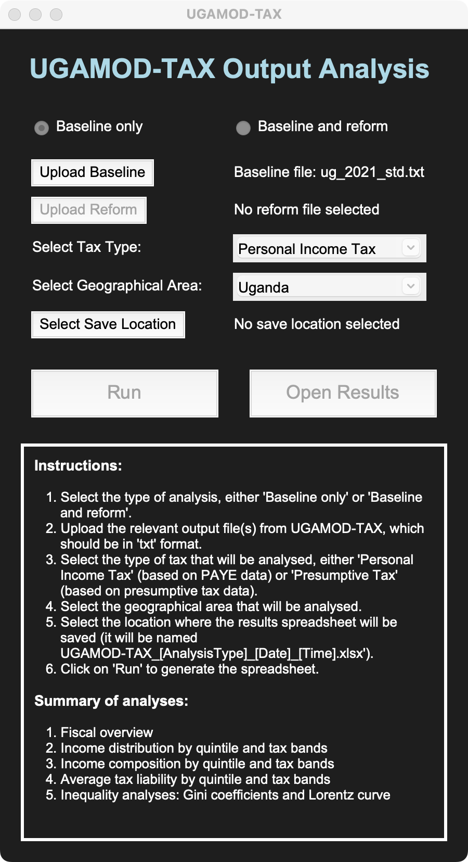
Coding: Writing code
SET OF PROMPTS:
Write Python code for a simple program interface:
The user can upload a Baseline and/or Reform output file, produced with a tax-benefit microsimulation model (txt files)
User can select ‘Baseline only’ or ‘Baseline and reform’
User can select the ‘Tax Type’ analysed (‘Personal Income Tax’ or ’Presumptive Tax’)
User can select the ‘Geographical Area’ analysed (Uganda, North, South, West, East)
There’s a ‘Run’ button
There’s an ‘Open Results’ button
At the bottom, there is a text field with instructions and summary of analysis (I’ll specify this later).
Let’s do this in steps. Note that after we are done with finished the interface, I’ll provide you with more information about the analysis that should occur when the user clicks on ‘Run’, and the files that will be produced.
Draft UI after an hour of iteration →
(o1-Preview via ChatGPT Plus web interface)

Slide 40
Other use cases in ‘coding’
PROMPT: I create a variable ‘temp’ inside a loop like this in Stata: […]. I received an error message: variable temp already defined r(110); How do I correct the error? Please debug.
PROMPT: Translate this Stata code to R: […]
PROMPT: I will soon get access to data on school enrollment rates in all the 96 provinces from 2010 to 2019, along with information on household income and average parental education.
You suggested a staggered DID approach as a suitable research strategy.
Since I don't have the actual data yet, could you please provide me with Stata code to generate a synthetic dataset that I can use to test my methods? You can assume 10 schools per province
PROMPT: Provide LaTeX code to create a graph depicting the basic elements of a supply and demand model in an economy. The graph should include a supply curve and a demand curve (straight lines) as well as the equilibrium price and quantity, with dashed vertical and horizontal lines from the point where the curves intersect.

Slide 41
Mathematical derivations
Setting up models
Deriving/solving equations
Explaining models

Slide 42
Mathematical derivations
LLMs are becoming increasingly better at mathematical reasoning and application
Set up common models and solve basic equations
Explain simple mathematical models and equations, aiding educational efforts
Caveats:
Not yet consistently reliable for high-level derivations; careful oversight needed
May eventually impact manual problem-solving skills

Slide 43
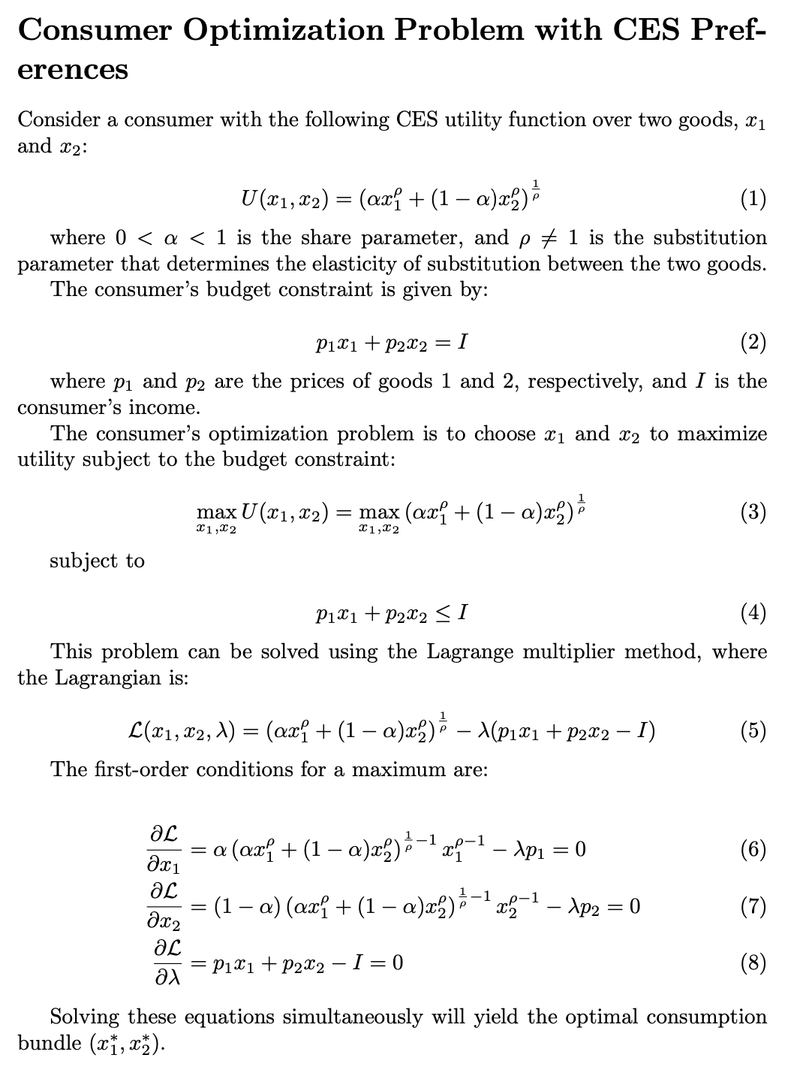
Mathematical derivations: Setting up models
PROMPT:
Set up the optimization problem of a consumer with CES preferences over two goods in LaTeX code.
RESPONSE (ChatGPT API):
[LaTeX code]
Copy-paste to LaTeX editor
From: Korinek, A. (2023): “Generative AI for Economic Research: Use Cases and Implications for Economists“. Journal of Economic Literature 61 (4): 1281–1317.

Slide 44
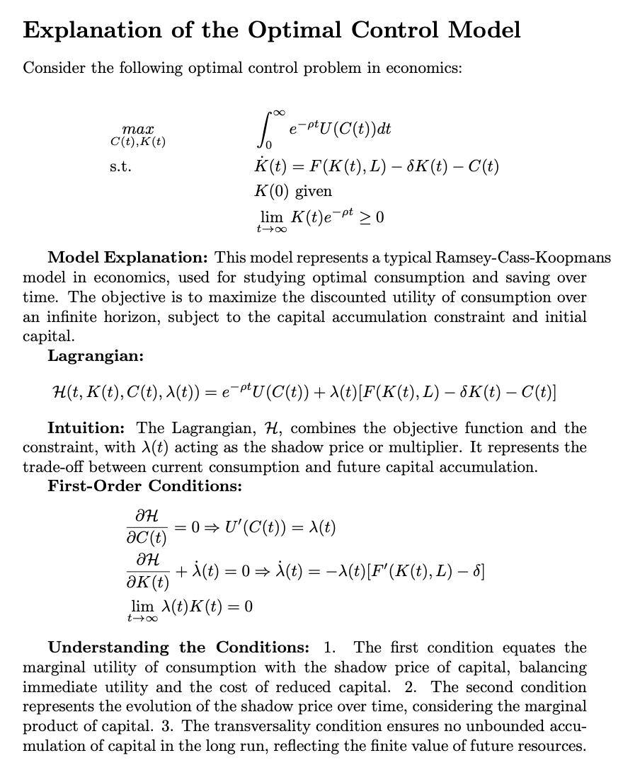
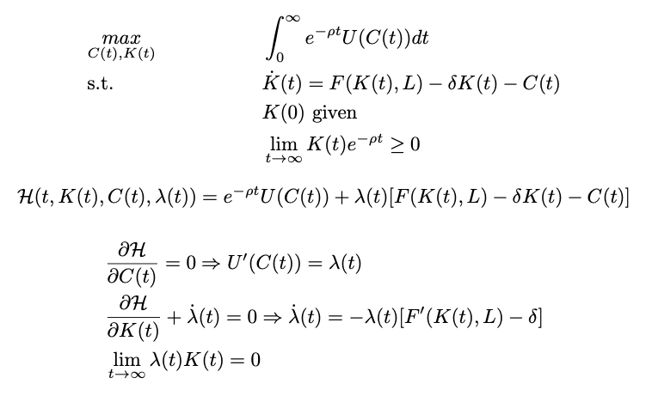
Mathematical derivations: Explaining models
PROMPT:
Can you explain what this model is, how to get from one step to the next, and what the intuition for each step is? Provide the full response in LaTeX format. [Equations pasted in LaTeX format.]
RESPONSE (GPT-4 via the ChatGPT Plus web interface):
[LaTeX code]
Copy-paste to LaTeX editor
From: Korinek, A. (2023): “Generative AI for Economic Research: Use Cases and Implications for Economists“. Journal of Economic Literature 61 (4): 1281–1317.

Slide 45
Data analysis
Creating figures from data
Extracting data
Reformatting data
Classifying and scoring text
Extracting sentiment
Simulating human subjects

Slide 46

Data analysis: Streamline data-related tasks
LLMs help format, extract, and classify data, and discern text sentiment
Generate and run code for analysis, with results presented in various formats
Produce figures or tables from datasets of your own, or data on websites
Replicate economic models
Caveats:
Complex analyses may lack accuracy
Extensive iteration recommended
Review outputs carefully for mistakes

Slide 47
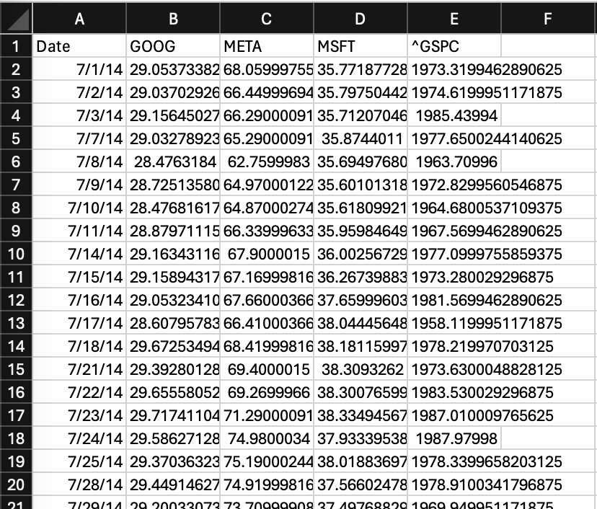
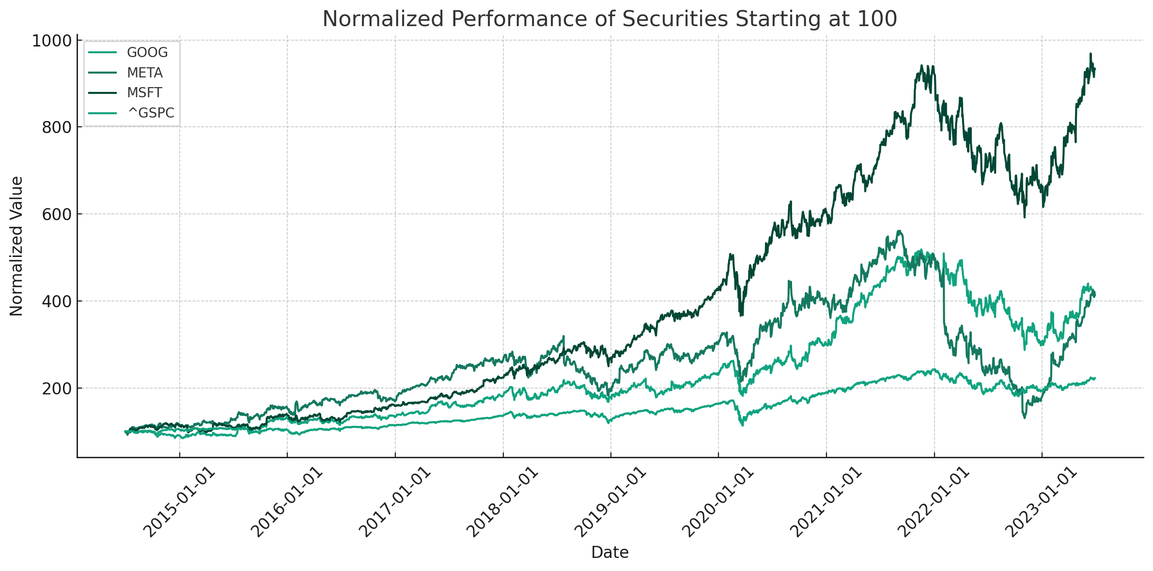
Data analysis: Creating figures from data
PROMPT: Please display a graph that shows the performance of these securities normalized to start at 100? (Attachment: stock_data.csv, which is itself generated via an LLM)
RESPONSE:
(GPT-4 via the ChatGPT Plus web interface, Advanced Data Analysis)
From: Korinek, A. (2023): “Generative AI for Economic Research: Use Cases and Implications for Economists“. Journal of Economic Literature 61 (4): 1281–1317.

Slide 48
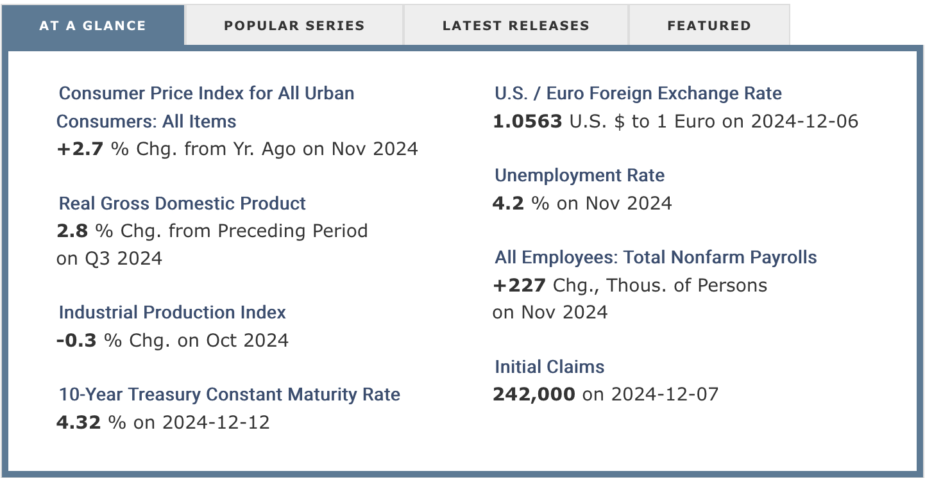
Data analysis: Extracting data
PROMPT: Go online to extract details of all 'At a glance' indicators (both indicator and current estimate).
It is available at: https://fred.stlouisfed.org
List in short bullet points.
RESPONSE: Here are the “At a Glance” economic indicators from the Federal Reserve Economic Data (FRED) website, along with their current estimates as of December 15, 2024:
Consumer Price Index for All Urban Consumers: All Items: Increased by 2.7% from a year ago in November 2024.
Real Gross Domestic Product: Grew by 2.8% in the third quarter of 2024 compared to the preceding period.
Industrial Production Index: Decreased by 0.3% in October 2024.
10-Year Treasury Constant Maturity Rate: Stood at 4.32% on December 12, 2024.
U.S. / Euro Foreign Exchange Rate: 1.0563 U.S. dollars per euro on December 6, 2024.
Unemployment Rate: At 4.2% in November 2024.
All Employees: Total Nonfarm Payrolls: Increased by 227,000 persons in November 2024.
Initial Claims: 242,000 claims on December 7, 2024.
These indicators provide a snapshot of the current economic conditions in the United States.
​.
(GPT-4o via the ChatGPT Plus web interface, incl. online search)

Slide 49
Data analysis: Extracting data
PROMPT: Go online to extract details of all 'At a glance' indicators (both indicator and current estimate).
It is available at: https://fred.stlouisfed.org
List in short bullet points.
RESPONSE: Here are the “At a Glance” economic indicators from the Federal Reserve Economic Data (FRED) website, along with their current estimates as of December 15, 2024:
Consumer Price Index for All Urban Consumers: All Items: Increased by 2.7% from a year ago in November 2024.
Real Gross Domestic Product: Grew by 2.8% in the third quarter of 2024 compared to the preceding period.
Industrial Production Index: Decreased by 0.3% in October 2024.
10-Year Treasury Constant Maturity Rate: Stood at 4.32% on December 12, 2024.
U.S. / Euro Foreign Exchange Rate: 1.0563 U.S. dollars per euro on December 6, 2024.
Unemployment Rate: At 4.2% in November 2024.
All Employees: Total Nonfarm Payrolls: Increased by 227,000 persons in November 2024.
Initial Claims: 242,000 claims on December 7, 2024.
These indicators provide a snapshot of the current economic conditions in the United States.
​.
(GPT-4o via the ChatGPT Plus web interface, incl. online search)

Slide 50

Other use cases in ‘data analysis’
Extracting sentiment
PROMPT: Below are excerpts from the U.N. World Economic Situation Prospects reports from 2020 (top) and 2021 (bottom) related to international tourism in 2019 and 2020. Summarize the sentiment of both excerpts in one bullet point, and label them on a scale from 1 (very negative) to 5 (very positive), explaining your reasoning.
"Confidence in global tourism remains positive yet cautious for the remainder of 2019. Weakening economic indicators, trade tensions and Brexit-related uncertainties have started to take a toll on business and consumer confidence. The UNWTO Confidence Index points to more moderate growth in arrivals during the period September-December 2019, particularly in Europe and the Americas. ... UNWTO estimates 3 to 4 per cent growth in international arrivals globally for 2019, reflecting rising tourism demand overall, though at a slower pace. At the regional level, prospects are strongest for Asia and the Pacific, where arrivals are expected to have grown 5 to 6 per cent"
”The tourism industry has been the hardest-hit services sector, as COVID-19 brought international travel to a virtual standstill from March 2020 onward. Before the pandemic, travel services accounted for almost one third of developing countries’ services exports. International tourist arrivals (overnight visitors) are estimated to have plunged by about 70 per cent globally in 2020 (UNWTO, 2020e), which would represent 1 billion fewer international arrivals than in 2019 and a potential loss of US$ 1.1 trillion in international tourism receipts, the largest decline ever. The shock has put 100 million to 120 million direct tourism jobs at risk, with large spill-overs into other sectors."
PROMPT: For each of the following registered voters, provide a one-word rating to indicate whether they are more likely to approve or disapprove of a policy proposal to loosen US immigration restrictions on highly-educated workers:
A 32-year old female lawyer in Houston, TX who is Hispanic
A 73-year old male retired doctor in Rome, GA who is Caucasian
A 25-year old software engineer in San Francisco, CA who is Asian and identifies as non-binary
A 45-year old female grocery check-out clerk in Brooklyn, NY who is second-generation Italian
A 55-year old male insurance agent in Lake City, FL who is Caucasian
Simulating human subjects
From: Korinek, A. (2023): “Generative AI for Economic Research: Use Cases and Implications for Economists“. Journal of Economic Literature 61 (4): 1281–1317.

